Slide 1
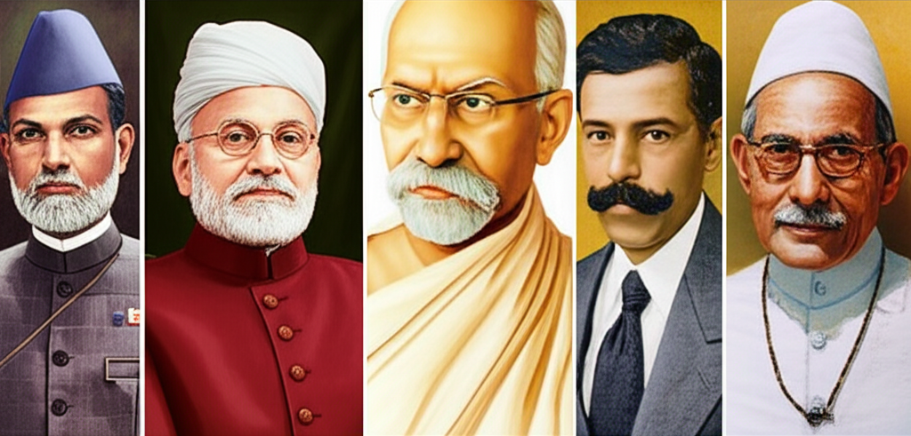
The Road to Freedom: Indian Independence
Exploring the journey of India's struggle for independence from British rule, a pivotal moment in global history. This presentation covers key events, figures, and the lasting legacy of this movement.

Slide 2

Key Movements and Milestones
These movements, led by various leaders, played crucial roles in escalating pressure on the British Raj. (Source: Wikipedia - Indian Independence Movement)
Non-cooperation Movement (1920-22): Mahatma Gandhi's call for civil disobedience against British rule.
Dandi March (Salt Satyagraha, 1930): Symbolic protest against the British salt monopoly, galvanizing mass participation.
Quit India Movement (1942): A forceful demand for immediate British withdrawal from India during WWII.

Slide 3
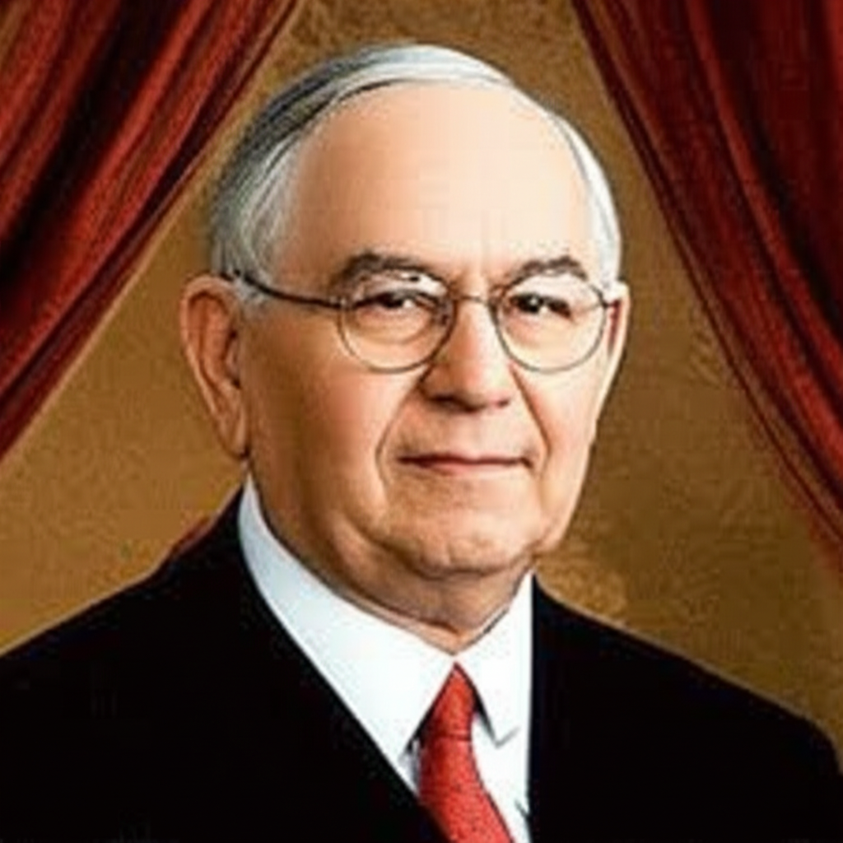
Architects of Independence
Mahatma Gandhi: The father of the nation, pioneer of non-violent civil disobedience. | Sardar Vallabhbhai Patel: Known as the 'Iron Man of India' for his role in integrating princely states.
Jawaharlal Nehru: India's first Prime Minister, a key figure in the struggle and post-independence nation-building. | Subhas Chandra Bose: Formed the Azad Hind Fauj (Indian National Army) to fight British rule.

Slide 4
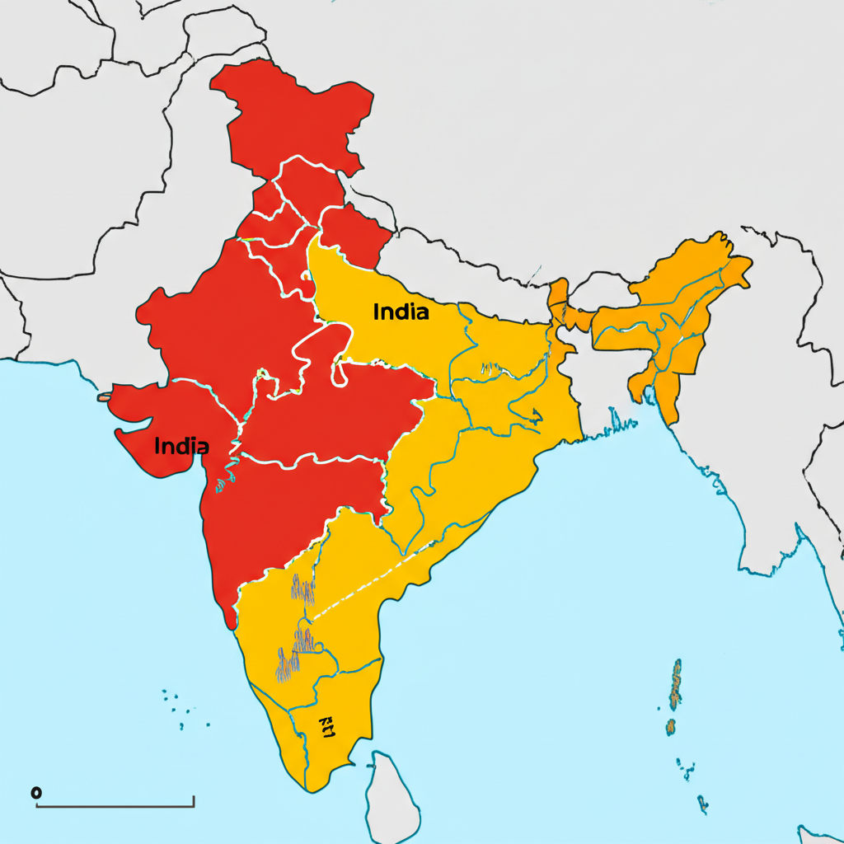
On August 15, 1947, India gained independence from British rule, but it came at the cost of partition into two separate nations: India and Pakistan. This event led to mass migration, communal violence, and long-lasting geopolitical implications. The decision to partition was a complex one, driven by political considerations and communal tensions, leading to one of the largest human migrations in history and immense suffering. (Source: The Partition of India, 1947 - National Archives, UK)

Slide 5

Legacy of Independence
The independence of India marked the end of an era of colonialism and inspired many other nations across Asia and Africa to fight for their freedom. (Source: United Nations - Decolonization)
Democratic Republic: India emerged as the world's largest democracy, upholding constitutional values.
Non-Aligned Movement: A cornerstone of India's foreign policy, advocating for peace and self-determination during the Cold War.
Economic Development: Focused on self-reliance and growth, transforming a colonial economy into a modern one.
Cultural Resurgence: Reclaiming and celebrating India's rich heritage and identity.

